Slide 1
Model View Controller-MVC
Unveiling the Power of Model View Controller (MVC) Architecture in Modern Development
By: Dr. T.M.Venthan

Slide 2
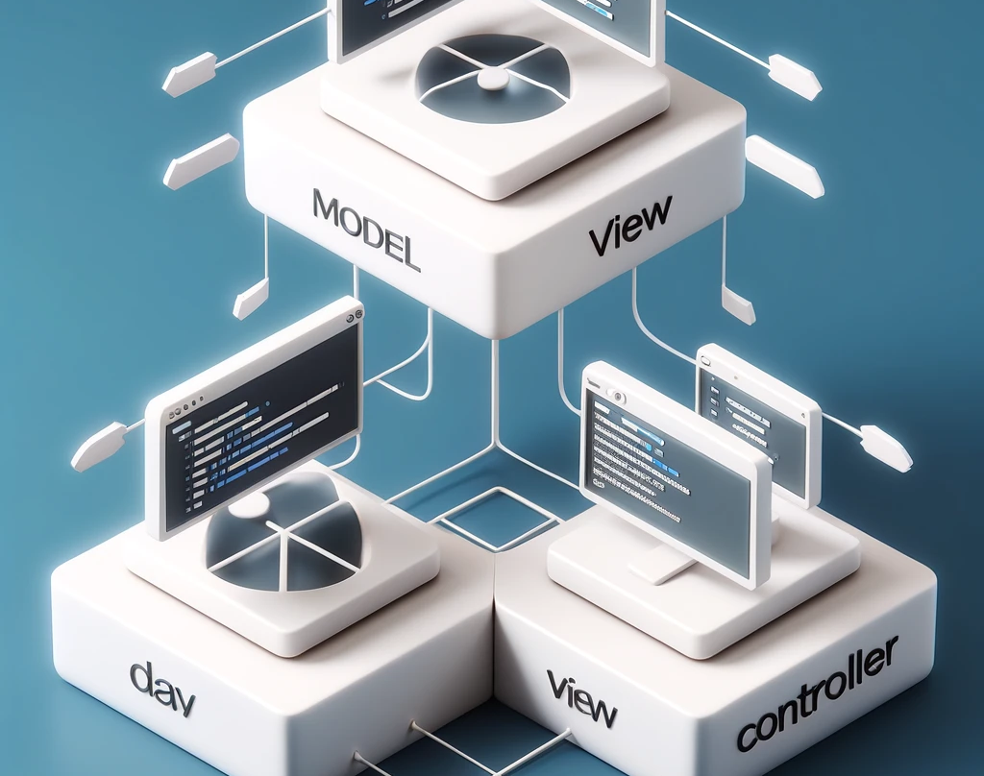
What is MVC?
M - Model
V - View
C - Controller
MVC is a design pattern for developing web applications.
One of the most popular design patterns.
Separates application logic, interface, etc.
Organized programming Environment.

Slide 3
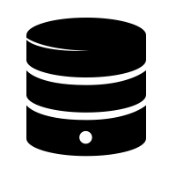
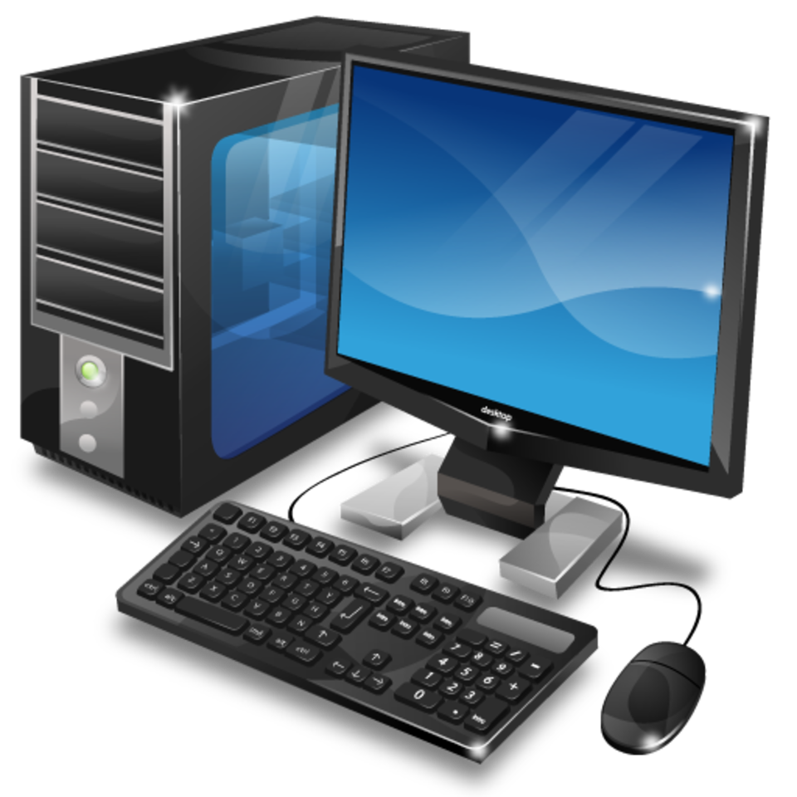
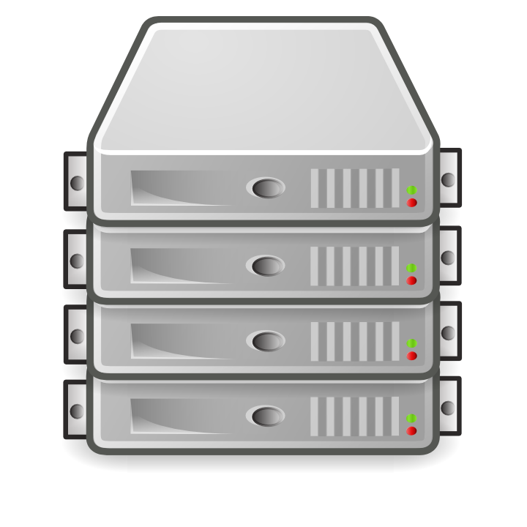
Model
Model
View
How the Internet Works
Database
Controller
Client
Server

Slide 4
Model
Interacts with the database
Data logic
Gets, Saves, Updates, etc
Communicates with Controller

Slide 5
View
User interface (UI)
Data presentation
Usually HTML/CSS/JavaScript
Communicates with Controller

Slide 6
Controller
Middle Man
Interacts with the user
Processes requests
Gets data from Model
Passes data to view

Slide 7
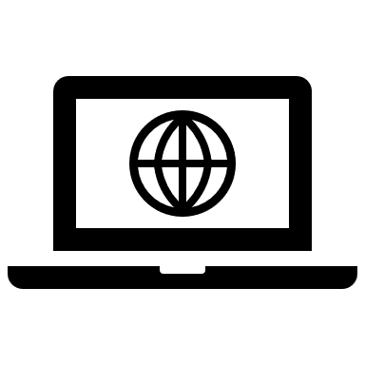
Model
Browser
MVC Diagram
Router
View
Model
Controller

Slide 8
Real-World Examples of MVC
Web Frameworks:
Ruby on Rails: A server-side web application framework.
ASP.NET MVC: A web application framework developed by Microsoft.
Django: A high-level Python web framework

Slide 9
Benefits of MVC for ICT Students
Career Readiness: Knowing MVC is important for web development jobs.
Competitive Edge: Employers look for people who know MVC.
Foundation for Advanced Concepts: MVC helps you learn more advanced development techniques.

Slide 10
Conclusion
Recap: Today, we talked about what MVC is, why it's important, how it works, and some real-world examples.
Final Thoughts: Learning MVC is crucial for a successful career in ICT. Just like knowing how to drive is essential for a taxi driver, understanding MVC is essential for web developers.

